Slide 1

DriverPass System Analysis
Kyle Latimer
Kyle.Latimer@snhu.edu
Southern New Hampshire University
Notes:
[No speaker notes required for this slide.]

Slide 2

System Requirements
Nonfunctional Requirements:
Performance Requirements
Performance Constraints
Accuracy
Precision
Adaptability
Security
Notes:
Nonfunctional Requirements
We will need to determine the nonfunctional requirements for our client as DriverPass. Those nonfunctional requirements will be performance requirements, Performance Constraints, Accuracy and Precision, Adaptability, and Security:
Performance Requirements
The stakeholders at Driver Pass have indicated that they do not want to deal with back up and security. They are open to the idea of running the web-based platform over the cloud. The stakeholders have also requested that data can be accessed remotely in order to obtain updated reports in addition to updates from the DMV. We should utilize a 3rd party cloud service provider such as Amazon Web Services to accomplish this goal.
Platform Constraints
Web based learning platform at DriverPass should be able to run on both Windows and Apple computer or laptop platforms. One constraint we have identified at DriverPass is the large amount of data that will be videos, lesson plans, and other data rich items. Due to the large amount of data, we will be primarily focusing on computer based operating systems and not mobile applications at this time. The back end cloud databases must have a high degree of security and information should be encrypted, as some sensitive information such as driver’s license numbers, social security and addresses with be stored on our database. Utilizing a cloud service will facilitate these needs, in addition to having the ability for rapid scalability in the future.
Accuracy and Precision
Users will create their own user identification. The system will check to ensure that particular identifier has been chosen or not. If the identification user name has not been selected, the system will create the account and prompt the user to enter a password. Passwords will be case sensitive, at least 8 characters or longer, will contain 1 or more numbers, and will have at least one special character (ie: !@#$%^&*). If the user name had already been selected by another user, the system will alert the customer and prompt them to enter another username. If issues arise, such as a forgotten password, locked account the system will alert the Administrator who will determine the next course of action. The Administrator will have the ability to reset passwords and reactivate accounts.
Adaptability
IT administrators at DriverPass will have the ability to make updates to the system and its data. The amount of downtime should be minimal if we utilize a 3rd party cloud provider. The IT Administrators will have the ability to delete data that is no longer needed, modify user accounts, and deactivate/ delete user accounts.
Security
Users will need to log in with their credentials, which is a username and password that is at least 8 characters long, contains a lowercase and uppercase value, a special character, and at least 1 number. Data exchange should be encrypted, as sensitive information exits on the database. If a user forgets their password, they will contact IT Administrators to have their passwords reset. A user will, get no more than 5 attempts to enter the correct credentials. An account will be locked if more than 5 attempts are made. IT administrators will have the ability to reset passwords and unlock suspended accounts.

Slide 3
System Requirements
Functional Requirements:
We need to explicitly determine every function of our system in order to plan how the system will interact with its various actors and function.
Notes:
Functional Requirements
Functional requirements are what they system will be doing. We need to explicitly determine every function of our system in order to plan how the system will interact with its various actors and function. The system shall:
The system shall be accessible through laptop and desktop computers.
The system shall utilize unique user credentials to so unauthorized access does not occur.
The system shall validate user credentials when a user logs in.
The system shall have a note taking feature for teachers.
The system shall have the ability to add/delete/update customer accounts on as needed basis.
The system shall secure sensitive data through encryption.
The system shall have easy to understand layouts for students and teachers.
The system shall have user profiles with photoidentification.
The system shall be accessible to administrators and managers whether on or offline.
The system shall have a function for scheduling lessons and road tests.
The system shall have a database that includes lesson plans, practice tests, and videos.
The system shall display progress, grades, and items of improvement where students need more work.
The system shall obtain updates from the DMV for driving policies and regulations.

Slide 4
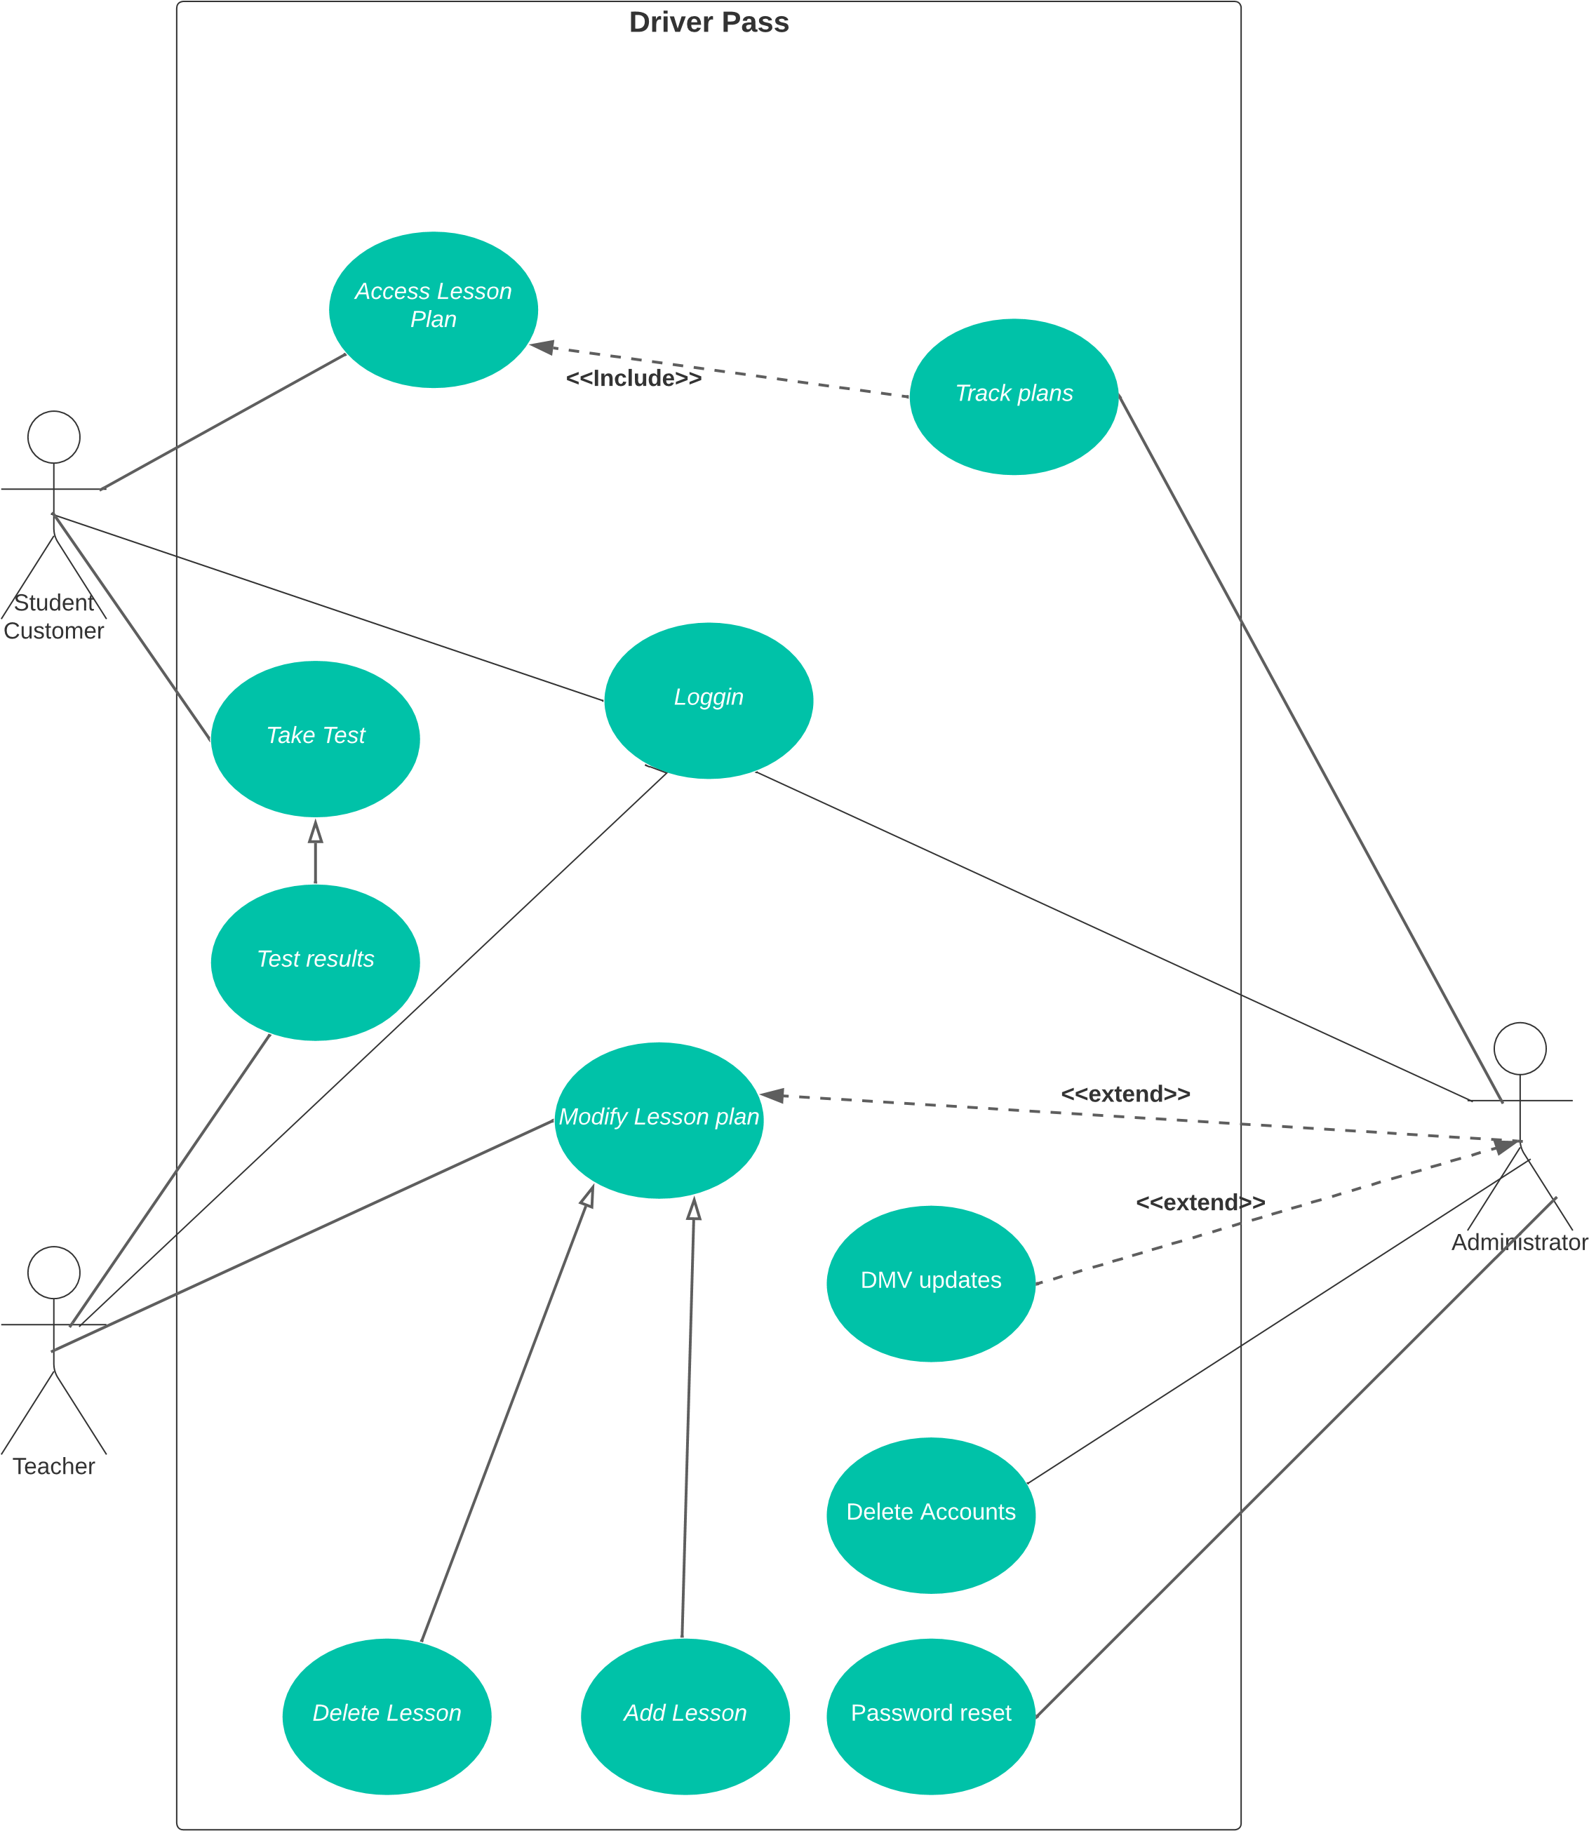
Use Case Diagram
Notes:
Our UML Case diagram shows how our system interacts with the 3 various actors. The 3 actors are the Student, Teacher, and Administrator. In this diagram, we can see all 3 actors must 1st log into the system with their credentials. The diagram shows what functions the Student have available to them, and what information they can view. They can access Lesson Plans and submit examinations after they are verified via their login credentials.
Next, we can see that Teacher, and what functions and information they can access. The teacher, like the student, can view lesson materials. The Teacher also has the ability to modify, add, or remove lessons in the DriverPass system. The Teacher can also view the Students’ exam submission and grades.
Next, we can see the Administrators functions, and what information they can access and modify. The Administrator must 1st login and input the correct credentials. Once logged in, the Administrator can do several things. One, they can reset login passwords for users who are locked out. The Administrator can also can modify and delete user accounts. The Administrator also has the ability to receive updates in policies from the DMV. This is an <<extend>> relationship, as it does not always occur, and only occurs when there are changes in DMV policy. The Administrator can also modify lesson plans and scheduling from Teacher users. Finally, the diagram shows that the Administrator can track scheduling and lesson plans. This is an <<include>> relationship, because the stakeholders from DriverPass indicated they always wanted to have the ability for Administrators to track this information and also have the ability to print it out in a report.

Slide 5
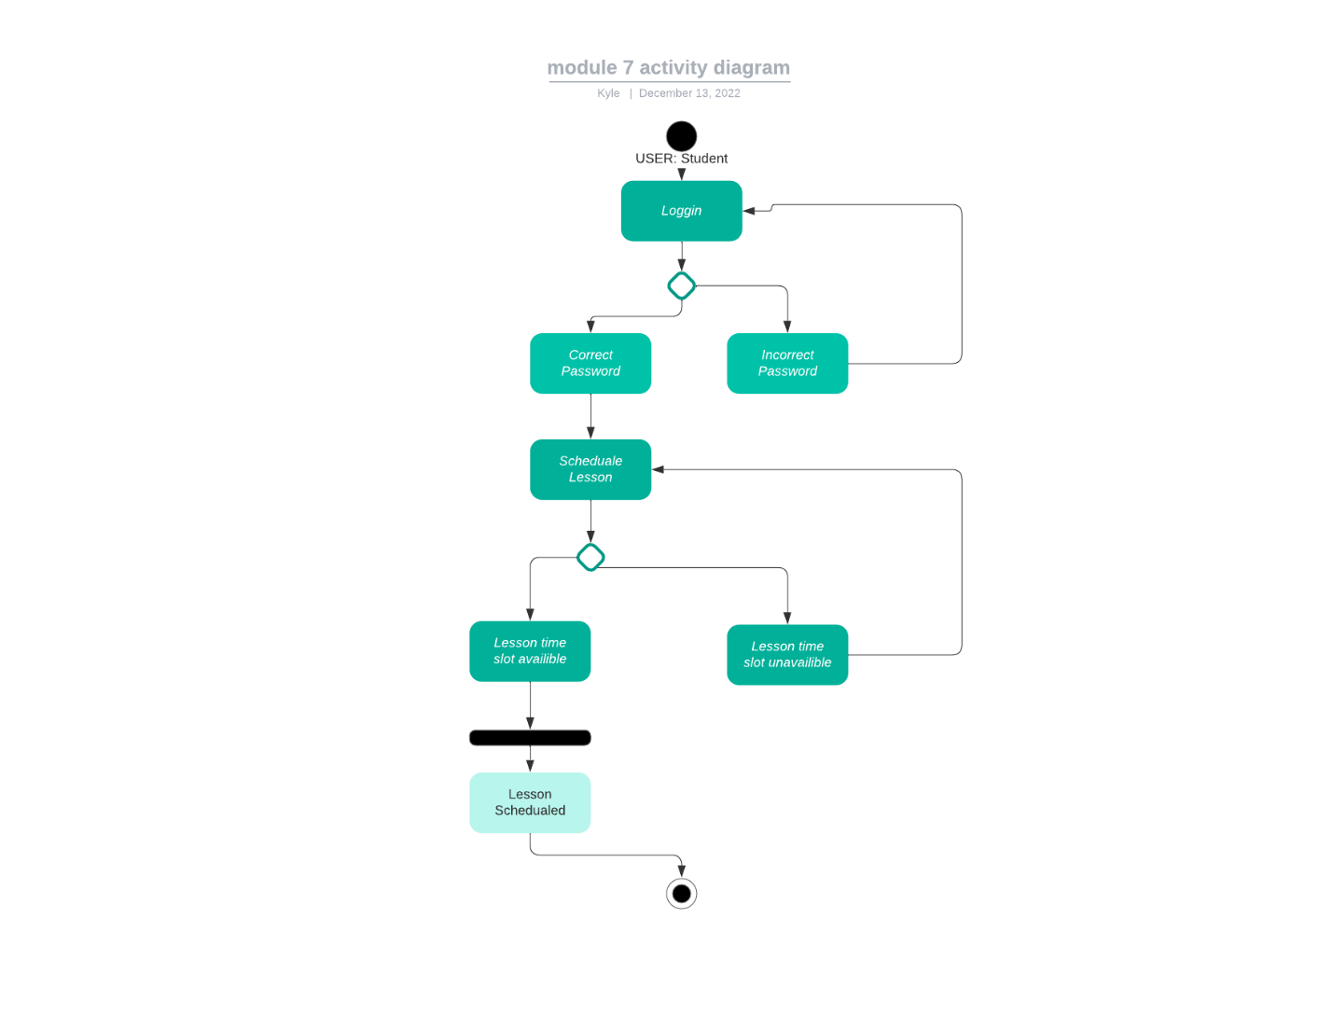
Activity Diagram
Notes:
In this UML Activity Diagram, we are viewing what the Student User. The Student User must 1st log in with their appropriate credentials. After providing the correct credentials, the Student can then schedule a lesson time slot. If the timeslot is available, the Student will have their requested time slot. If not, the system will loop, and inform the user that the time slot was not available, and to ask for another time slot.

Slide 6
Security
SECURITY:
Password Strength
Sensitive data encryption
3rd party cloud service
Notes:
Users will need to log in with their credentials, which is a username and password that is at least 8 characters long, contains a lowercase and uppercase value, a special character, and at least 1 number. Data exchange should be encrypted, as sensitive information exits on the database. If a user forgets their password, they will contact IT Administrators to have their passwords reset. A user will, get no more than 5 attempts to enter the correct credentials. An account will be locked if more than 5 attempts are made. IT administrators will have the ability to reset passwords and unlock suspended accounts. The system will also utilize a 3rd party could service. This will assist in remaining secure by having state of the art security, without the need for new, expensive hardware that requires periodic downtime for updates and maintenance.

Slide 7
System Limitations
Limitations:
Time
Cost
3rd party cloud service provider contracts.
Notes:
DrivePass has a current anticipated limitation include the cost for the 3rd party cloud service provider. Another anticipated limitation is time. We currently have from January 22 2022 until May 10 2022, which is a difficult time line to provide such an extensive project.

